Slide 1
Defensive Security Project
by: [Tyler Mills & Aaliyah Lockett]

Slide 2
Table of Contents
This document contains the following resources:
Monitoring Environment
Attack Analysis
Project Summary & Future Mitigations

Slide 3

Monitoring Environment
‹#›

Slide 4
Scenario
[A company know as VSI, specializes in design of virtual reality programs. There was cyber attack conducted from a company to dispute revenue and business operations. During the analysts we will be working within their SOC. We are given serval logs. Are job is to analyst them, detect the line of attacks, nad create thresholds to prevent them. ]

Slide 5
[“Add-On” App]
‹#›

Slide 6
Logs Analyzed
Windows Logs
Apache Logs
1
2
Windows_servers_logs.csv
Windows_server_attack_logs.csv
apache_logs.txt
apache_attack_logs.txt

Slide 7
Windows Logs
‹#›

Slide 8
Reports—Windows
Designed the following Reports:
Report Name | Report Description
[Signatures and associated signature IDs] | [Description of the user and possible compromising of their accounts]
[Severity levels] | [These Reports will show the severity of the attacks that the company have been facing]
[Success and failure] | [This report show the success and failed attempts on attacks ]

Slide 9
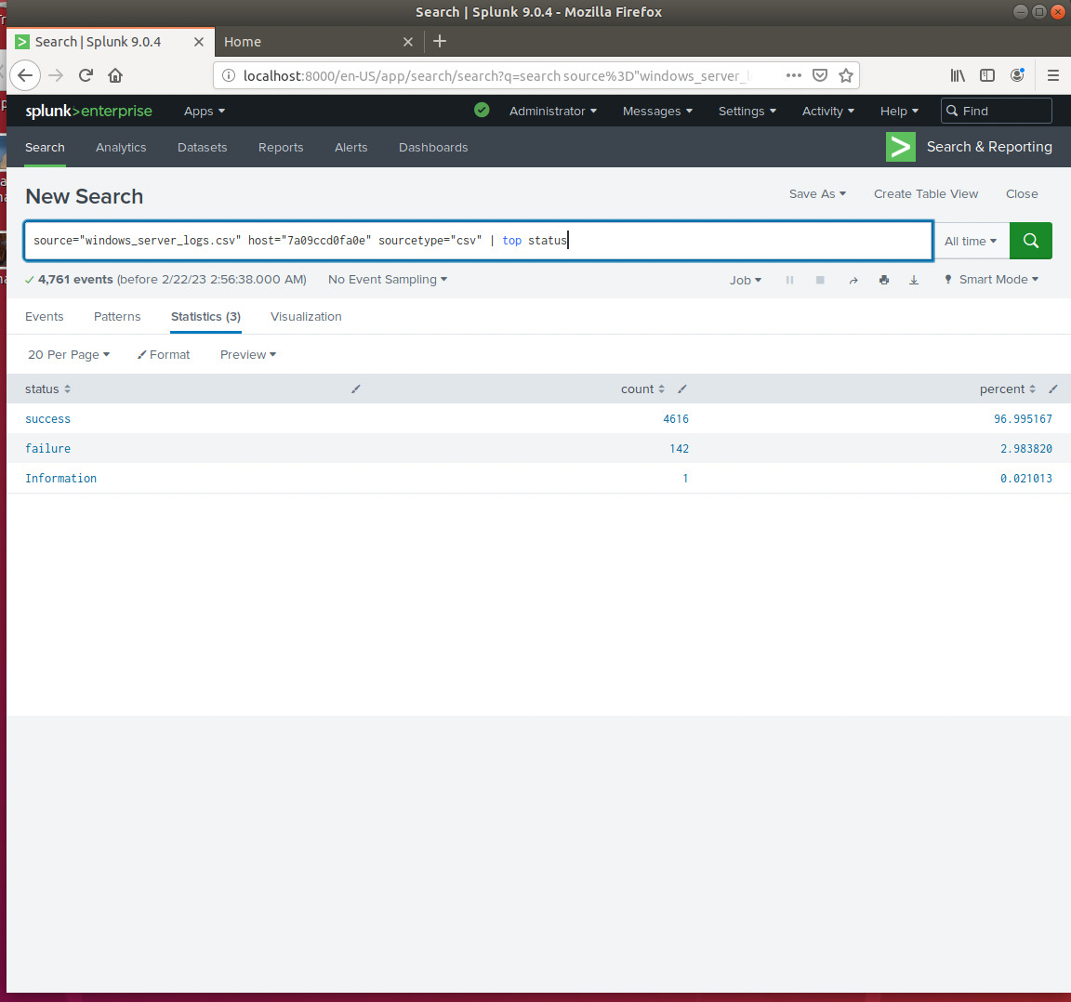
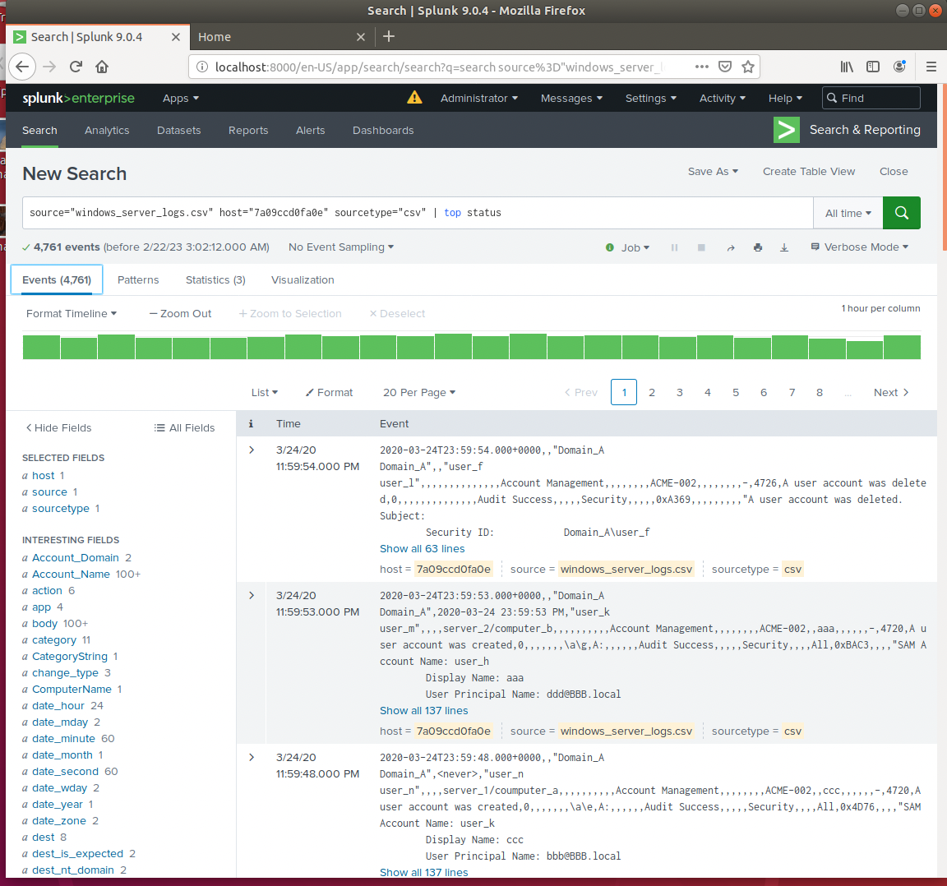
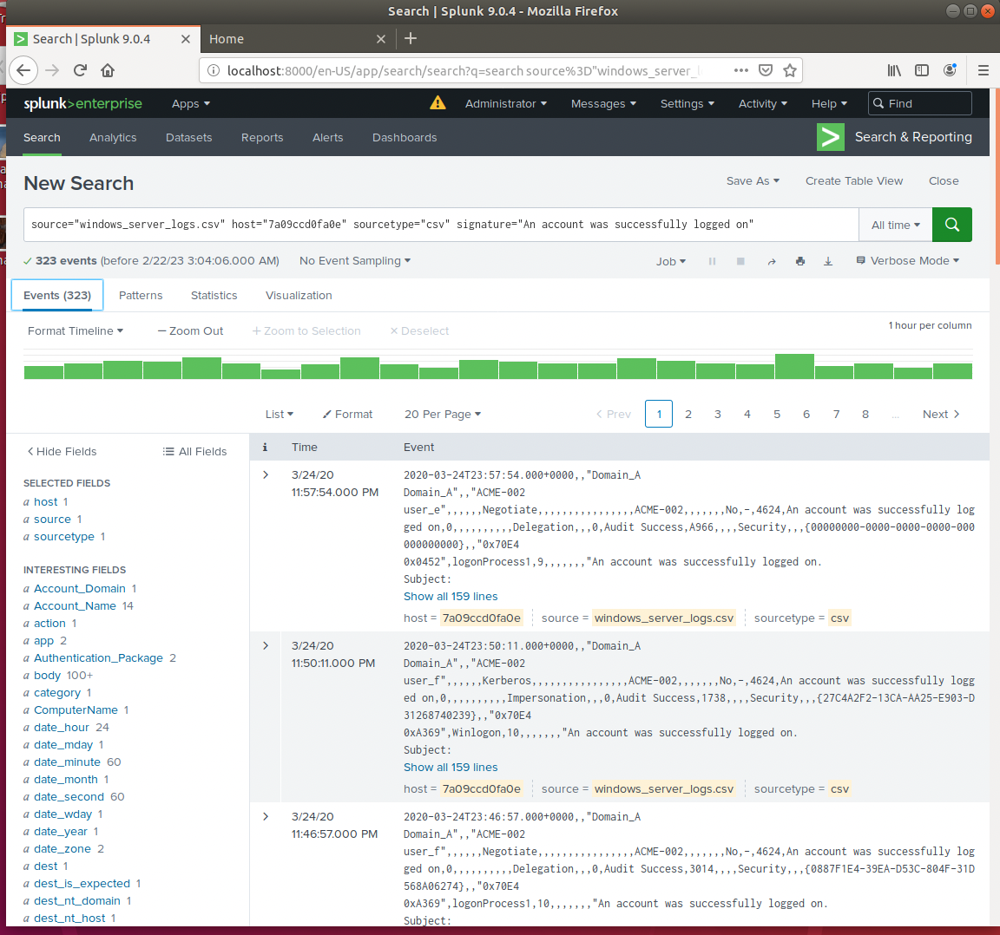
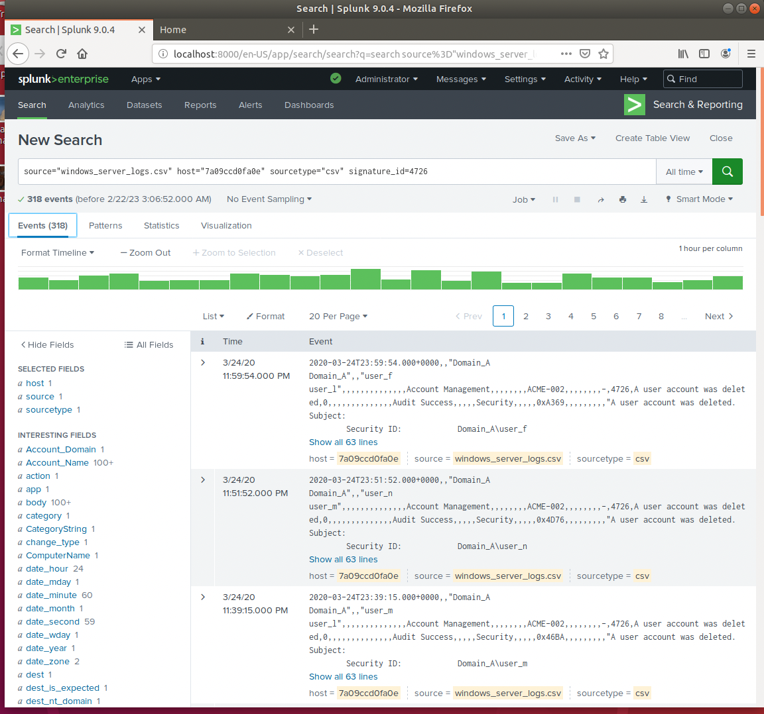
Images of Reports—Windows
Report Image
Report Image
Report Image
Report Image

Slide 10
Alerts—Windows
Designed the following alerts:
Alert Name | Alert Description | Alert Baseline | Alert Threshold
[Delete Account] | [This will set off an alert if 10 or more accounts are deleted] | [5] | [10]
There is a high number of accounts that getting deleted within te data from the logs. Having the threshold at ten seemed to be a good measure to insure that the exploit will be noticed.

Slide 11
Alerts—Windows
Designed the following alerts:
Alert Name | Alert Description | Alert Baseline | Alert Threshold
[Status Failure] | [Alerts when failure to log in the event above the threshold] | [7] | [15]
On tw average there was roughly 7 made failed login attempts every hour on the hour. This allowed to make a baseline with the given data. With making the threshold to keep for faster monitoring.

Slide 12
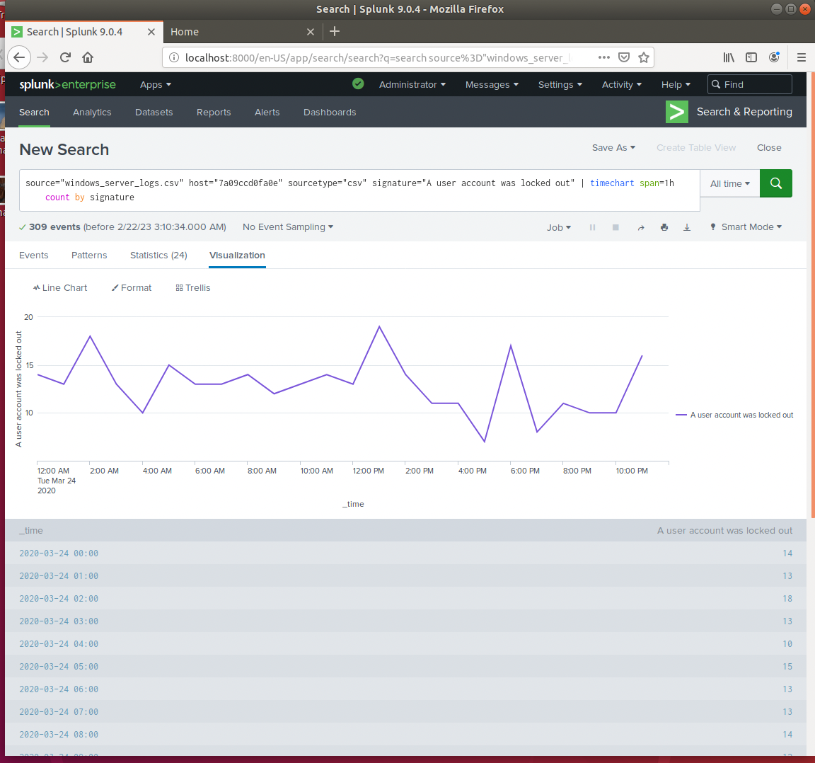
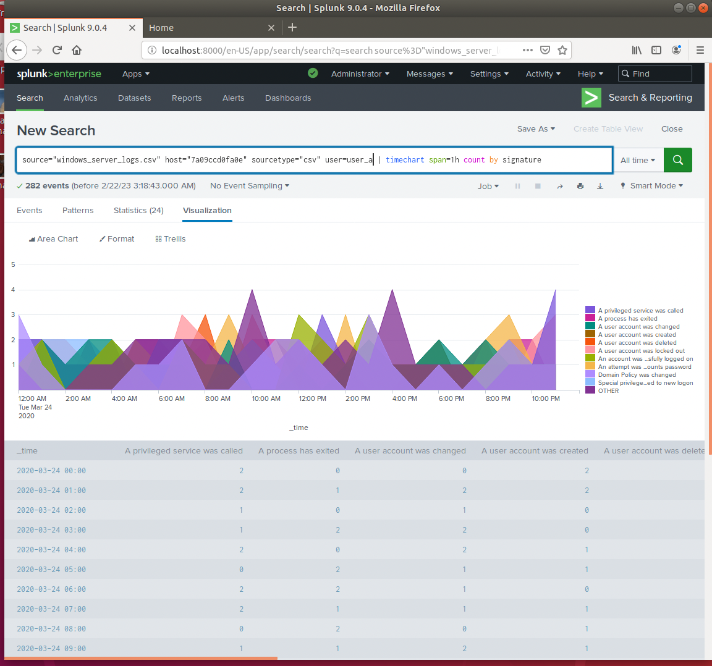
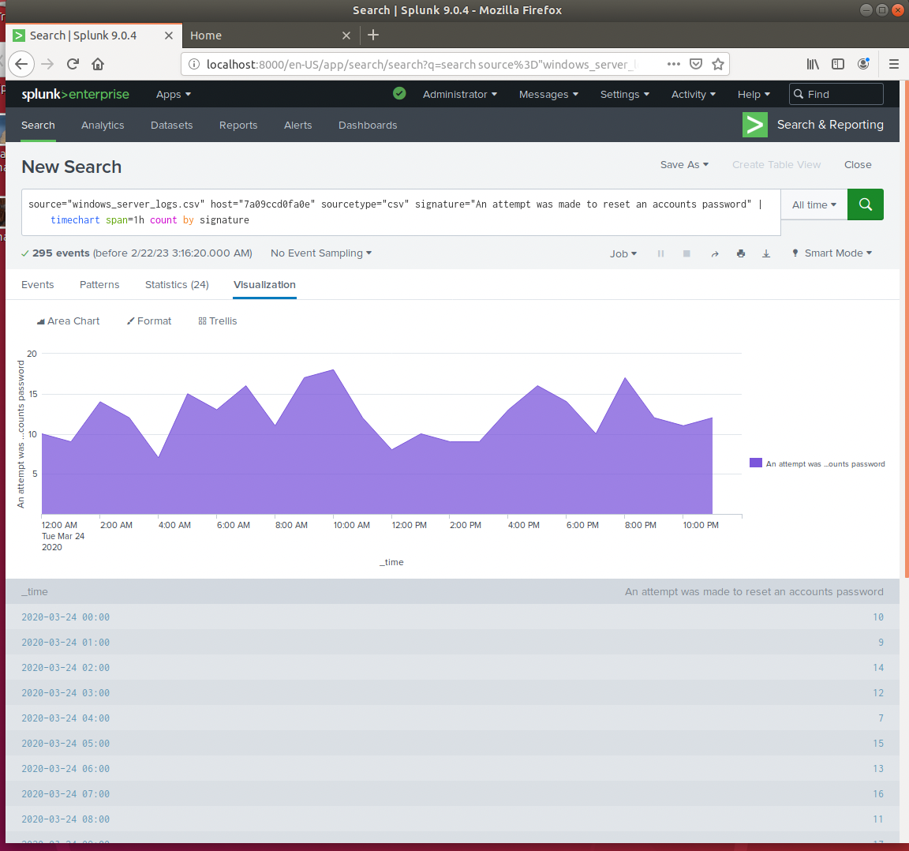
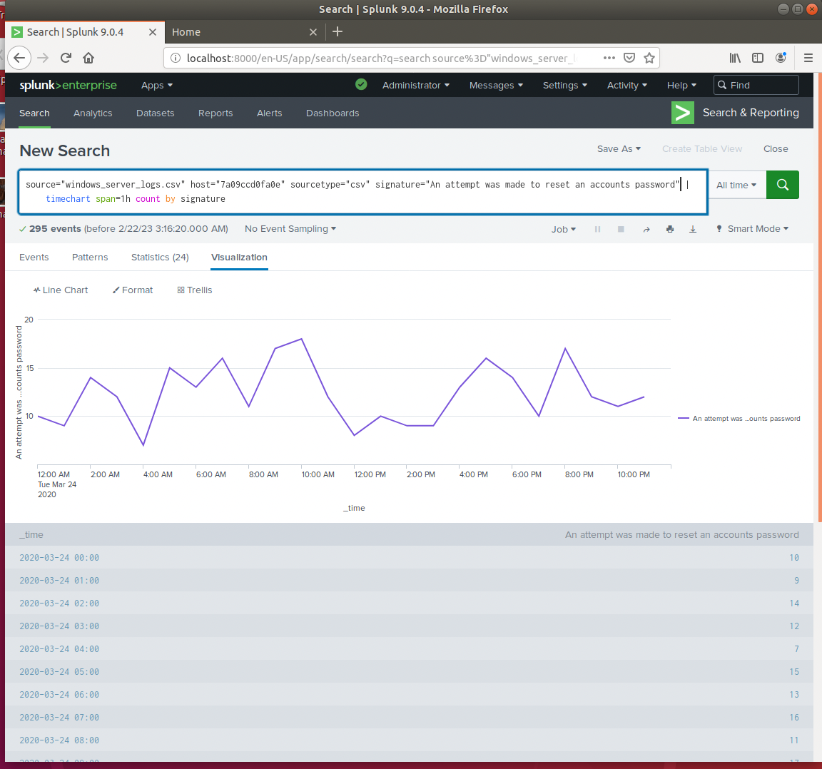
Dashboards—Windows
Place image here
Place image here
Place image here
Place image here

Slide 13
Apache Logs
‹#›

Slide 14
Reports—Apache
Designed the following reports:
Report Name | Report Description
[Domain Address] | [Shows all domain addresses that on the VSI server]
[Method info] | [Shows method of Vsi information]
[Stats Count by URL] | [Shows links to the vsi website]
[HTTP response] | [Displays the response codes for the apache logs]

Slide 15
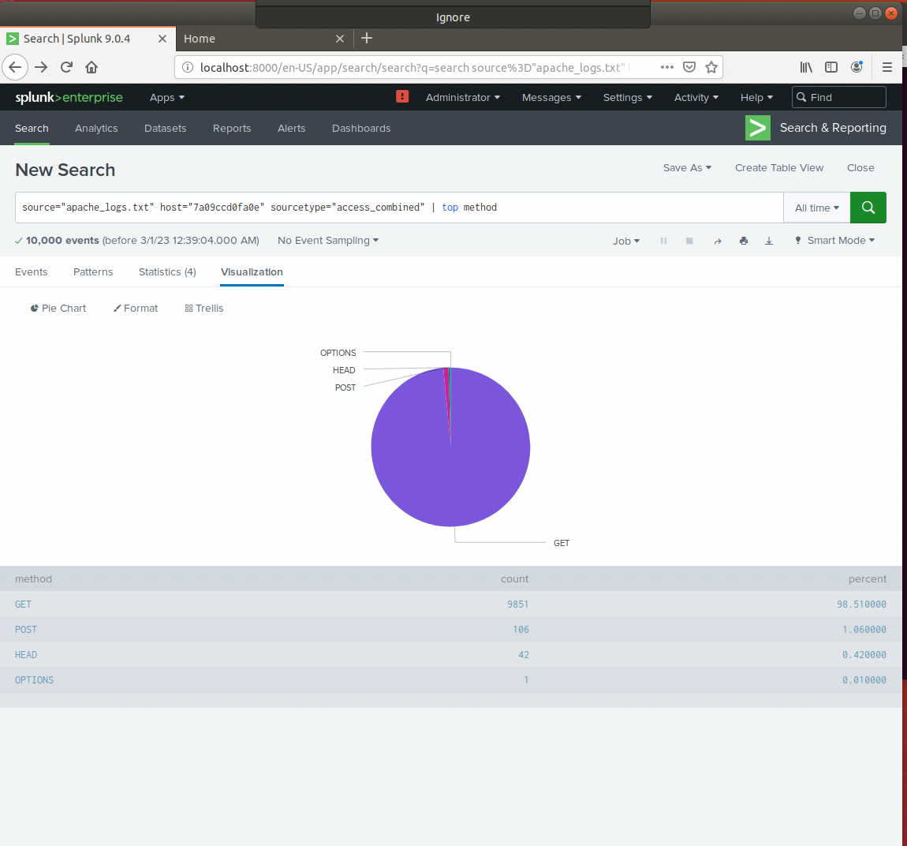
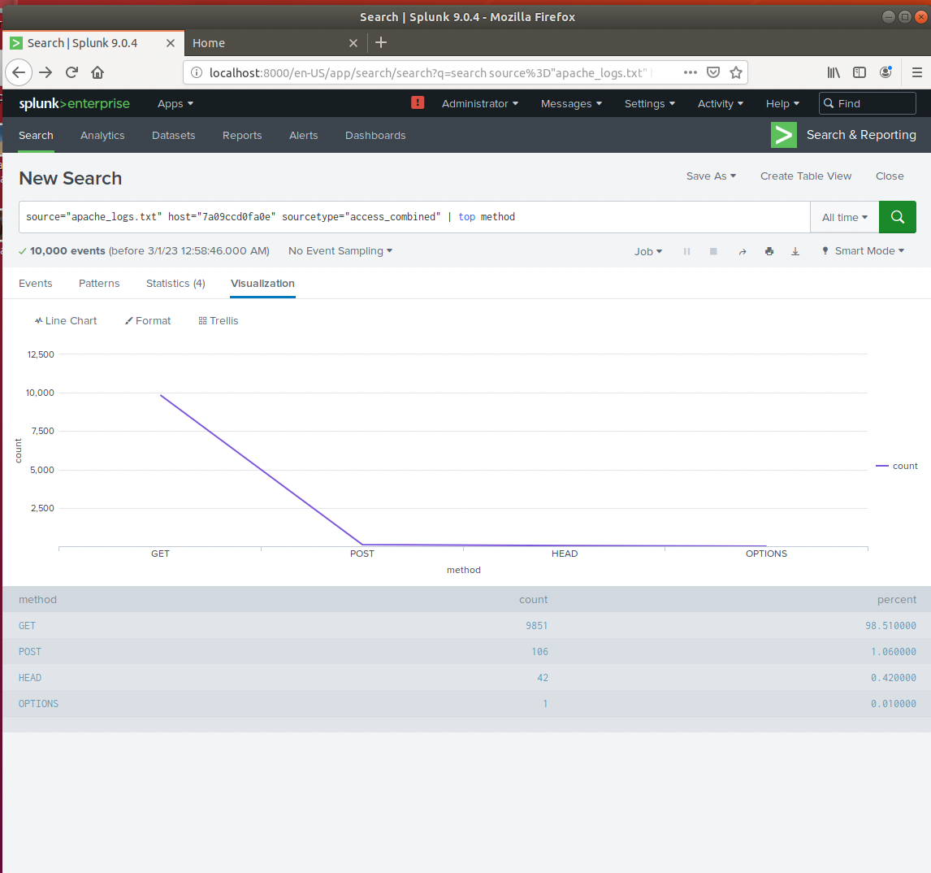
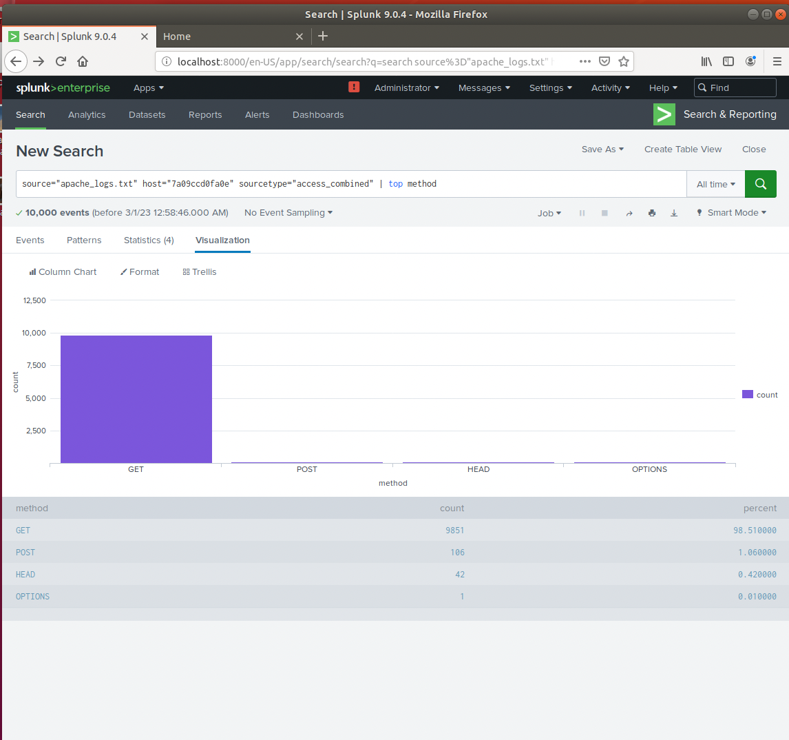
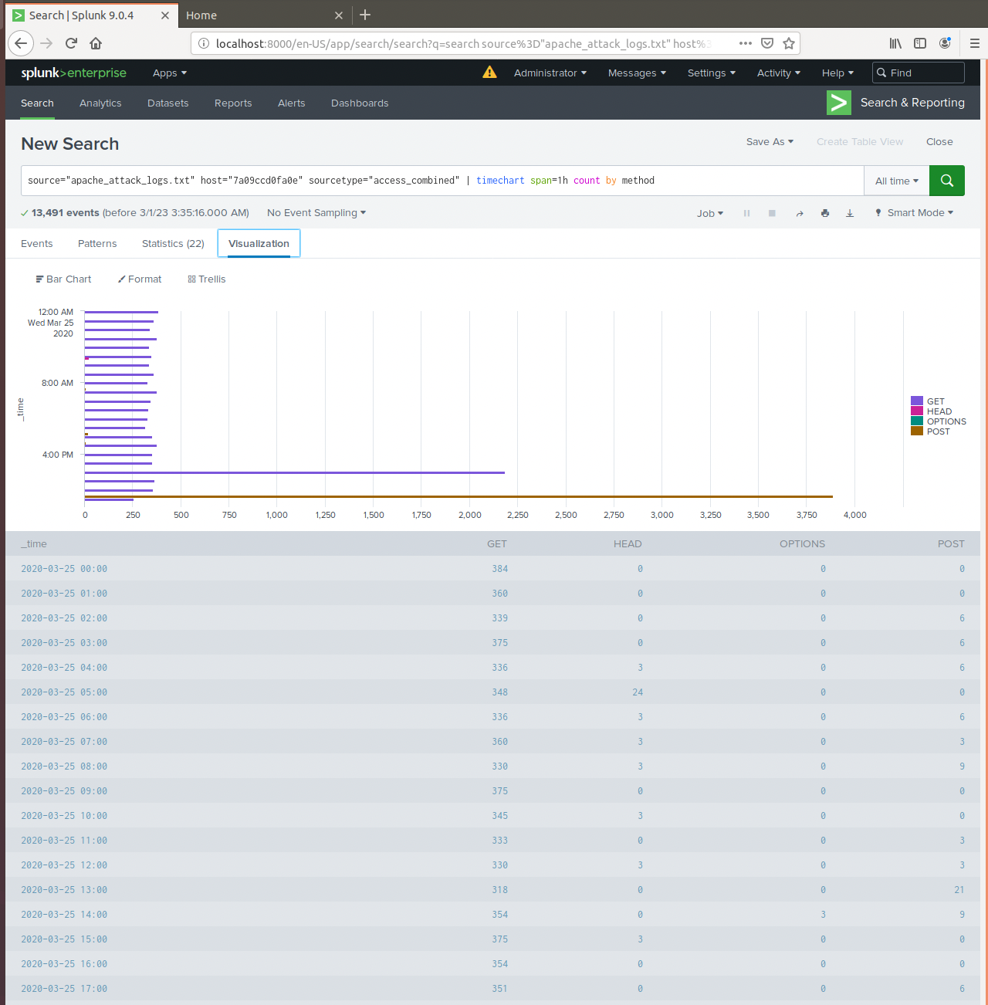
Images of Reports—Apache
Report Image
Report Image
Report Image
Report Image

Slide 16
Alerts—Apache
Designed the following alerts:
Alert Name | Alert Description | Alert Baseline | Alert Threshold
[HTTP POST] | [Description of alert] | [3] | [>5]
When comparing the attack logs and the daily logs it seemed as if the timeframe of the attacks accrued for fours on both the 24th and 25th of march. The HTTP post will alert us in the attack with te threshold >5.

Slide 17
Alerts—Apache
Designed the following alerts:
Alert Name | Alert Description | Alert Baseline | Alert Threshold
[HTTP POST method] | [This observes the requests from the client to the server] | [3] | [5]
After reviewing the logs it was showed that a solid baseline number will be 3 and a solid threshold is 5

Slide 18
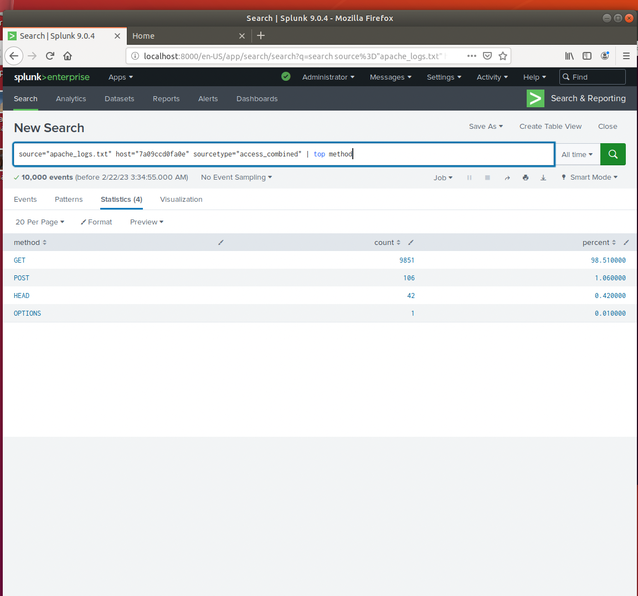
Dashboards—Apache
Place image here
Place image here
Place image here
Place image here

Slide 19
Attack Analysis
‹#›

Slide 20
Attack Summary—Windows
Summarize your findings from your reports when analyzing the attack logs.
• Report Analysis for Methods
o Suspicious increase in POST request method
o Decrease in GET request method
• Report Analysis for Referrer Domains
o Significant decrease in top 10 referrer domain counts
• Report Analysis for HTTP Response Codes
o Significant decrease in 200 (successful) response codes and a significant
increase in 404 (failed) response codes.

Slide 21
Attack Summary—Apache
Summarize your findings from your reports when analyzing the attack logs.
• Report Analysis for Methods
o Suspicious increase in POST request method
o Decrease in GET request method
• Report Analysis for Referrer Domains
o Significant decrease in top 10 referrer domain counts
• Report Analysis for HTTP Response Codes
o Significant decrease in 200 (successful) response codes and a significant
increase in 404 (failed) response codes.

Slide 22
Attack Summary—Apache
Summarize your findings from your alerts when analyzing the attack logs. Were the thresholds correct?
• suspicious volume of international activity
o 47 events between the hours of 4am and 8pm (16 hrs)
m raise threshold
suspicious volume of HTTP POST activity
1296 events on 03-25-2020
raise threshold

Slide 23
Attack Summary—Apache
Summarize your findings from your dashboards when analyzing the attack logs.
• Time chart of HTTP methods shows an increase in GET and POST requests
between 6pm-9pm
o Peak count of 1415 POST events
• Cluster map shows high volume of activity in Tokyo, Japan
o 26 events
• URI Data dashboard shows increase in "account_logon" and
"Company_homepage" URI
o possible brute force attack

Slide 24
Summary and Future Mitigations
‹#›

Slide 25
Project 3 Summary
What were your overall findings from the attack that took place?
Looking at the information provided, on Wed Mar 25, 2020 the website was
under a DOS from 9:00AM-12:00PM. The attack started at 8:00AM, this attack
managed to take the website down for 3 hours.
To protect VSI from future attacks, what future mitigations would you recommend?
This sorts of attacks can be mitigated by adding a load balancer and a reliable
server. The load balancer would help re-redirect traffic to help ease load on the
server though different data points. Use a website traffic detection service to help detect early high volumes of incoming traffic. Configure the network to respond and intellengy drop malicious bot traffic.

